Slide 1
R&S®ARDRONIS Automatic Radio-controlled Drone Identification Solution
October 21st 2016
Jens Kühne
Technical Project Leader

Slide 2
R&S®ARDRONIS Highlights
High reliability / low false alarm rate:
drone monitoring based on the analysis of the remote control (RC) links
Early warning:
a very fast response solution, even before take-off
Situational awareness:
achieve an overview of all the active drones and automatic alarming of threats in a defined area
Advanced geolocation:
accurate direction finding of remote operator and drone
Effective countermeasures:
counter threats early on with a smart jammer (reactive and selective jamming with low-power pulses)

Slide 3
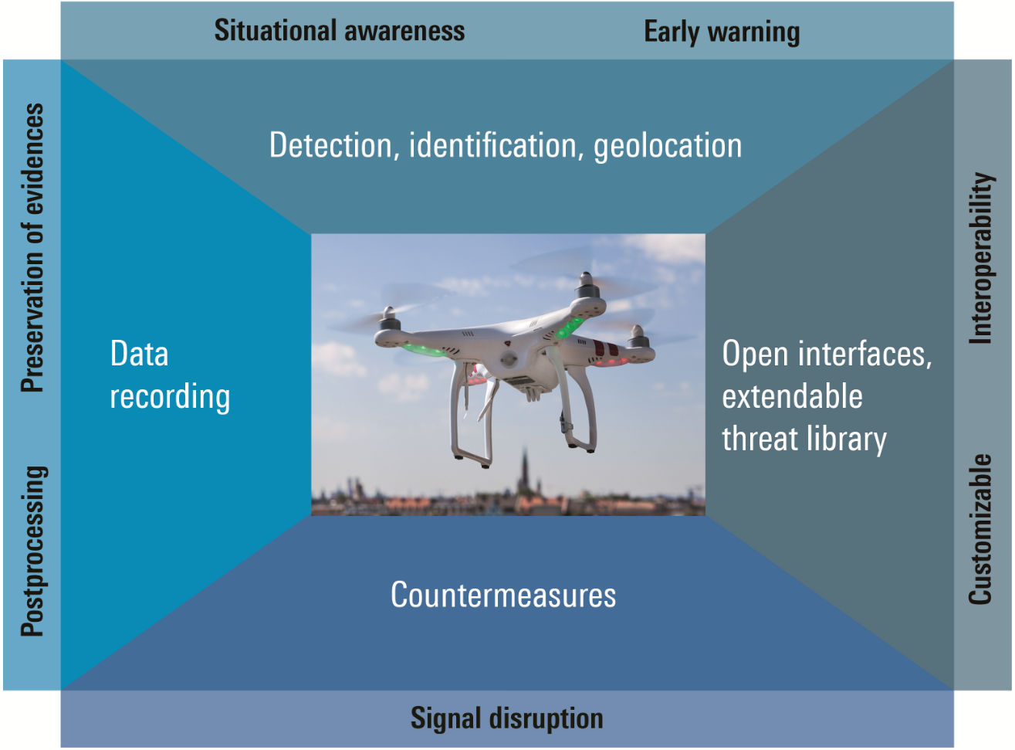
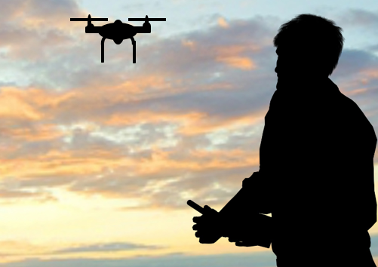
R&S®ARDRONIS - Automatic Radio-Controlled Drone Identification Solution
ARDRONIS Mission!
A comprehensive “all-in-one solution” countering the threats arising from FHSS and Wi/Fi controlled micro drones
Detection, identification, direction finding, locating, recording, and jamming operations
A highly automatic integrated operational workflow

Slide 4
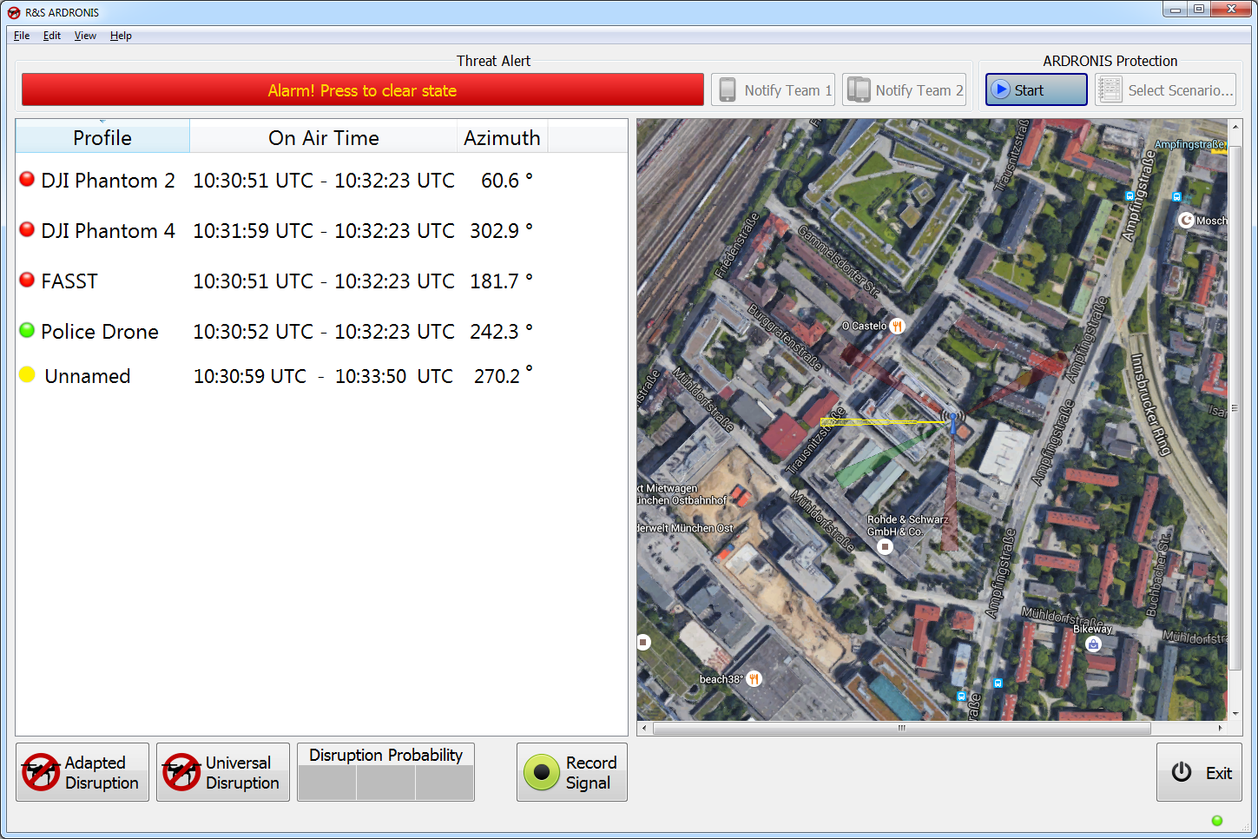
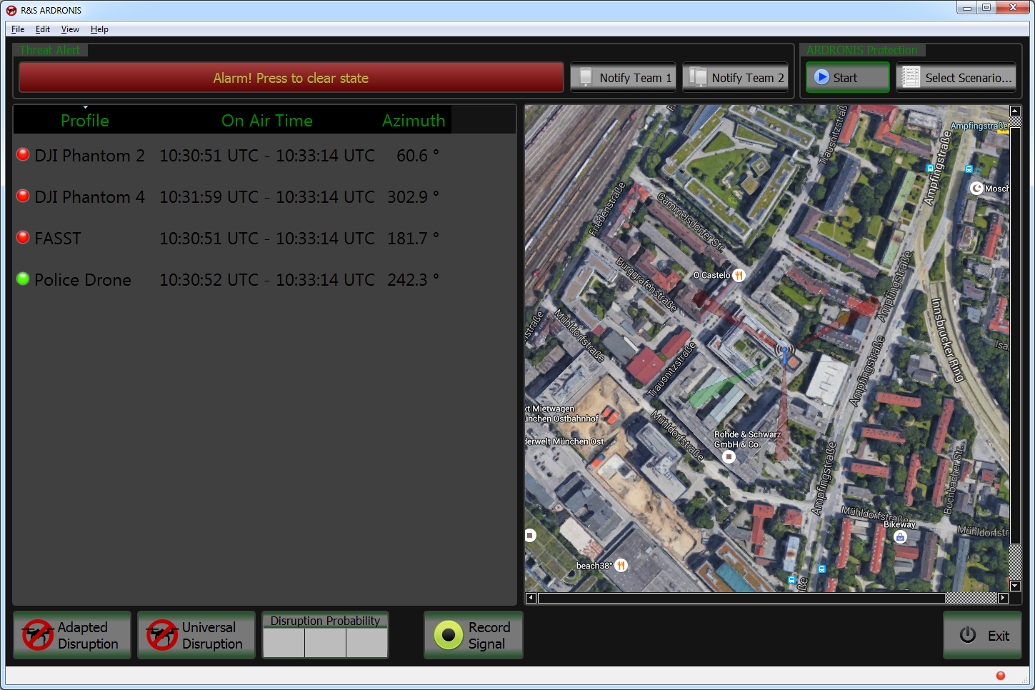
Highly Automatic Integrated Operational Workflow Key Features
Full automatic monitoring solution for all kind of FHSS/WLAN drones
Ergonomically designed GUI
Automatic triggering alarm/ notification when RC profiles are being detected and displaying the video link
Automatically check for video-downlinks once a remote control had been identified
R&S®ARDRONIS GUI

Slide 5
Effective Detection and Identification Key Features
Detection coverage is tentatively the distance covered by the radio control link (depending on Tx-power)
Remote control with 100 mW (EU Standard): ~1 km
Remote control with booster: ~3 km
Display video link if transmitted via PAL/ NTSC or Wi-Fi
Automatic identification based on defined profiles (includung the relevant RC technical parameters). The identification result can be sorted into :
Black list (i.e. threats)
White list (i.e. own drones)
Unnamed (i.e. new/unknown drones)

Slide 6
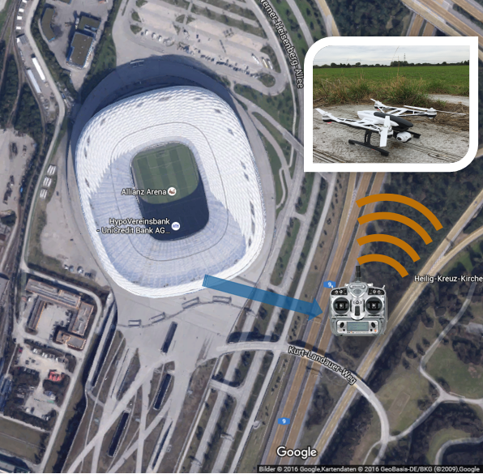
Accurate Direction Finding Key Features
Direction finding of the remote control operator and drone, depending upon the existing up- and downlink
Remote control operator (uplink)
Drone (e.g. telemetry downlink)
Advanced DF antenna: multi-element direction finding antennas with superior DF accuracy, sensitivity and immunity to reflections
High performance two-channel DF: simultaneous direction finding and emission analysis with outstanding probability of interception
21.10.2016
R&S®ARDRONIS

Slide 7
R&S®ARDRONIS - Automatic Radio-Controlled Drone Identification Solution

Slide 8
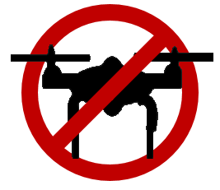
Countermeasures Key Features
The aim is to disrupt the connection between the remote control and the drone
Most drones have a selectable “fail safe” mode in case they lose their control signal, this “fail safe” mode can be:
Safe landing at current position (i.e. controlled landing)
Return to home or predefined position (e.g. power on position)
For FHSS/DSSS controlled drones: every single signal burst contains the full control information, thus each single burst will be jammed
For Wi-Fi controlled drones: the Wi-Fi connection will be interrupted
21.10.2016
R&S®ARDRONIS

Slide 9
Countermeasures Key Features
With this low power approach (500 mW), jamming is possible from about 2/3 distance to the remote control under line-of-site conditions
Highly effective, fast and reliable jamming of every single RC burst with low power pulses of ~500 mW … 4 W
Follower jammer technology (reactive and selective jamming) with virtually no disturbance of other communication signals within the same ISM band (e.g. Wi-Fi, Bluetooth …)
The profile of all identified RC signals will be configured automatically
~600m
Follower Jammer
ADRONIS
~900m
Protection Area
Detection Area

Slide 10
R&S®ARDRONIS - Automatic Radio-Controlled Drone Identification Solution

Slide 11
Preservation of Evidences Key Features
Data recording (an automatic smart-recording solution) that allowing the collection of evidences:
Recording of received drone up- and downlinks
Recording of event log files
Recording of video datastreams
Optional postprocessing:
Detailed technical analysis of the remote control used, after identification of the radio events
Collection of evidences

Slide 12
R&S®ARDRONIS - Automatic Radio-Controlled Drone Identification Solution

Slide 13
Open Interface, Extendable Threat Library Key Features
R&S ARDRONIS
Open Interface, customizable and interoperable
Open interfaces - XML interface provides opportunity for integration into 3rd party solution
User can integrate ARDRONIS into larger systems, e.g. including Radar-sensors, cameras, etc…
Extendable database/ threat library
The profile library of remote control is constantly extended by R&S
The library can also easily be extended by the operator
ARDRONIS
Customer solution
(radar, E/O, acoustic …)

Slide 14
R&S®ARDRONIS Applications
The key functionalities of R&S®ARDRONIS include: identification, direction finding and countermeasures
These functionalities are categorized in four packages to meet users’ specific technical requirements
Packages
Functionalities
Identification
Direction Finding
Countermeasures
R&S®ARDRONIS
Detection
.
Identification
Identification + Direction Finding
Identification + Countermeasures
Identification + Direction Finding + Countermeasures
R&S®ARDRONIS Direction
.
.
R&S®ARDRONIS Disruption
.
.
R&S®ARDRONIS Protection
.
.
.

Slide 15
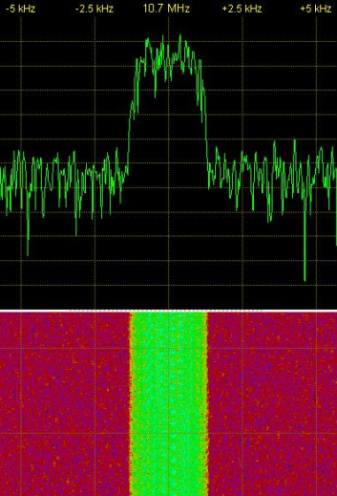
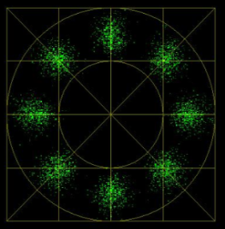
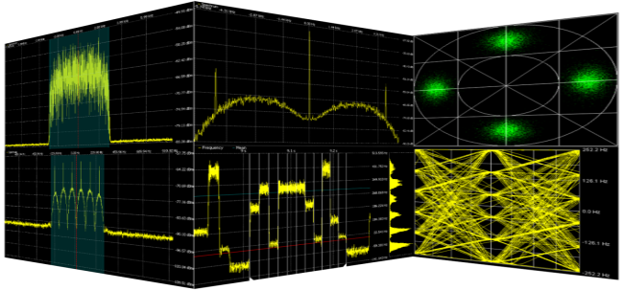
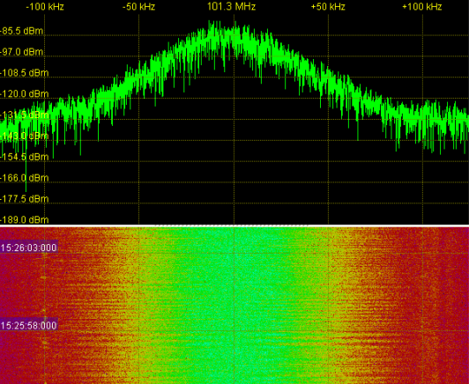
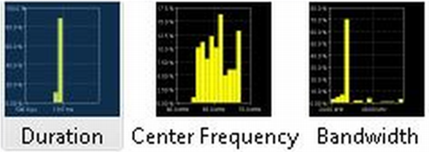
R&S®ARDRONIS
Introduction
Thank you for your time and for your attention!

